Slide 1
Software Requirement Engineering
By: Farah Jabeen

Slide 2

Requisite Team Skills for Effective Requirements Management
Six team skills that are necessary for a modern software team to successfully address the requirements challenge are mentioned here
Team Skill 1, Analyzing the Problem
Team Skill 2, Understanding User and Stakeholder Needs
Team Skill 3, Defining the System
Team Skill 4, Managing Scope
Team Skill 5, Refining the System Definition
Team Skill 6, Building the Right System

Slide 3
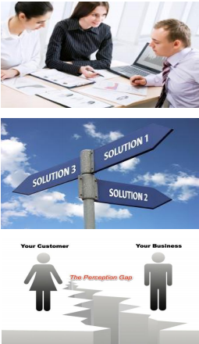
Problem Analysis [1]
Sometimes, the simplest solution is a workaround, or revised business process, rather than a new system.
Changing the user's desire or perception may be the most cost-effective approach to address a problem.
Practical experience shows many examples where changing the perception led to the highest-quality , fastest, and cheapest solutions available
As problem solvers, it is recommended to explore these alternative solutions before leaping into a new system solution.
However, when these alternative activities fail to reduce this gap, then we have to actively change the distance between perception and desire by defining and implementing new systems

Slide 4

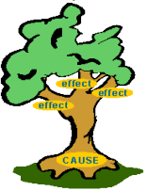

Steps of Problem Analysis [1]
The goal of problem analysis is to gain a better understanding, before development begins, of the problem being solved.
Gain agreement on the problem definition.
Understand the root causes—the problem behind the problem.
Identify the stakeholders and the users.
Define the solution system boundary .
Identify the constraints to be imposed on the solution.

Slide 5
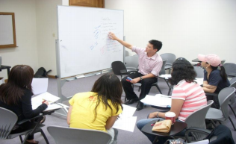
Gain Agreement on the problem definition
The first step is to gain agreement on the definition of the problem to be solved.
One of the simplest ways to gain this agreement is to simply write the problem down and see whether everyone agrees.
It is often helpful to understand some of the benefits of a proposed solution.
Having the user describe the benefits provides additional contextual background on the real problem.

Slide 6
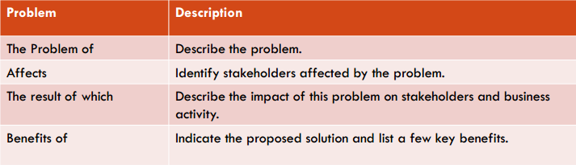
The problem Statement
You may find it helpful to write your problem down in a standardized format (Table 1).
Table 1: Problem Statement Format

Slide 7
Step 2: Understand the Root Causes
Once you have an understanding of the larger problem, your team can use a variety of techniques to gain an understanding of its causes.
One such technique is root cause analysis, which is a systematic way of uncovering the root, or underlying, cause of an identified problem.
For example,
Consider a real-world example: a company , GoodsAreUs, manufactures and sells a variety of inexpensive , miscellaneous items for home and personal use.
As the company addresses the problem of insufficient profitability, it uses total quality management (TQM) techniques for problem solving
Based on this experience, the company quickly focused on its cost of nonconformance, which is the cost of all the things that go wrong and produce waste, scrap, and other excess costs.
Notes:
Total Quality Management (TQM) system is the management method where the confidence in quality of all organization processes is placed foremost. The given method is widely used in production, in educational system, in government organizations and so on

Slide 8
Step 2: Understand the Root Causes
This cost includes rework, scrap , customer dissatisfaction, employee turnover, and other factors that are negative-value activities.
Production waste, or "scrap," was found to be one of the largest contributors after quantification of its cost of non quality
This problem of excess scrap , then, is the next problem the company is trying to solve since it directly affects the larger problem of the cost of nonconformance, which in turn affects profitability
TQM teaches us the use of the fishbone diagram (see Figure 1) to identify the problems behind the problem. Each source that contributes towards failure are listed as one of the "bones" on the diagram.

Slide 9
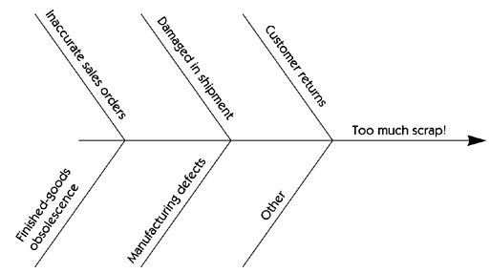
Figure 1: Fishbone diagram of Root Causes

Slide 10

Step 2: Understand the Root Causes
OK, so how do you determine the root causes? In many cases, it's a simple matter of asking the people directly involved what they think the root cause is.
If the problem is more serious then it may be necessary to perform a detailed investigation of each contributing problem and to quantify its individual impact.
This could vary from perhaps simple brainstorming by participants to a small data collection project or, potentially, to a more detailed experiment.

Slide 11
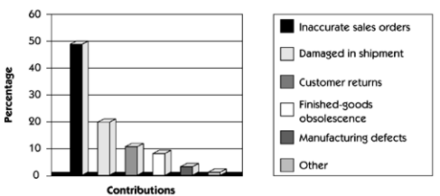
Addressing the Root Cause
We might like to fix all of the root causes on the "bones" of the diagram.
But data shows that a number of root causes are simply not worth fixing, as the cost of the fix exceeds the cost of the problem.
How do you know which ones to fix? You must determine the contribution, of each root cause. The results of this investigation can be plotted as a Pareto chart [3] or a simple histogram [4] that visually exposes the real culprits.
Figure 4: Pareto Chart of Root Causes

Slide 12
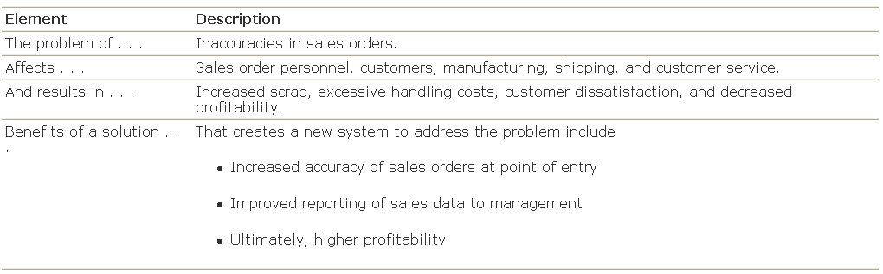
Addressing the Root Cause
Once we have identified inaccurate sales orders as a root cause of a problem worth solving, we can create a problem statement for the sales order entry problem, as seen in Table 2
Table 2: Sales Order Problem Statement
Once written, the problem statement can be circulated to the stakeholders for comment and feedback.

Slide 13
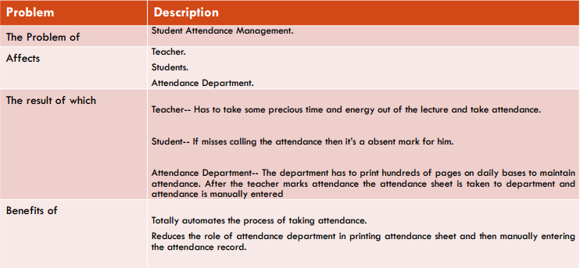
Addressing the Root Cause
Example 2
Table 3: Attendance System Problem Statement

Slide 14
Step 3: Identify the Stakeholders and the Users
Understanding the needs of the users and other stakeholders is a key factor in developing an effective solution.
Effectively solving any complex problem typically involves satisfying the needs of a diverse group of stakeholders.
Many stakeholders are users of the system, and their needs are easy to focus on because they will be directly involved with system use.
However , some stakeholders are only indirect users of the system or are affected only by the business outcomes that the system influences.
For example, they include the people and organizations involved in the development of the system, the subcontractors, the customer's customer, e.t.c
Non user stakeholder needs must also be identified and addressed.

Slide 15
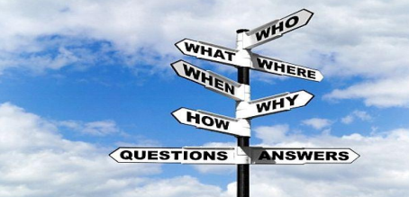
Step 3: Identify the Stakeholders and the Users
The following questions can be helpful in this process.
Who are the users of the system?
Who is the customer (economic buyer) for the system?
Who else will be affected by the outputs the system produces?
Who will evaluate and approve the system when it is delivered and deployed?
Are there any other internal or external users of the system whose needs must be addressed?
Who will maintain the new system?
Is there anyone else who cares?

Slide 16

Step 4: Define the Solution System Boundary
Once the problem statement is agreed to and the users and stakeholders are identified, we can turn our attention to defining a system that can be deployed to address the problem.
In so doing, we enter an important transition state wherein we have to keep two things in mind:
an understanding of the problem and
the considerations of a potential solution.
The next important step is to determine the boundaries of the solution system.
The system boundary defines the border between the solution and the real world that surrounds the solution (Figure 4).
Information, in the form of inputs and outputs, is passed back and forth from the system to users.
Figure 4: The inputs/system/outputs relationship

Slide 17
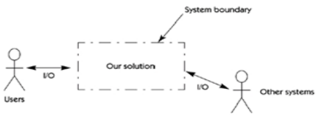
Step 4: Define the Solution System Boundary
We divide the world in two:
Our System
Things that interact with our system
Let's identify the "things that interact with our system" generically as "actors on our system."
Once we understand the concept of an actor, we can illustrate a system boundary as shown in Figure 5
Figure 5: The inputs/system/outputs relationship

Slide 18
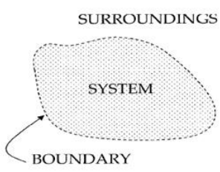
Step 4: Define the Solution System Boundary
How do we find these actors? Here are some helpful questions to ask.
Who will supply, use, or remove information from the system?
Who will operate the system?
Who will perform any system maintenance?
Where will the system be used?
Where does the system get its information?
What other external systems will interact with the system?

Slide 19
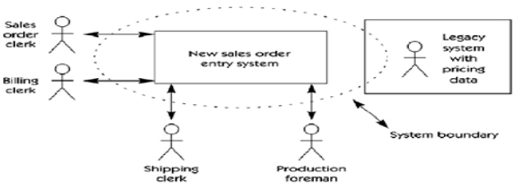
After identifying the actors, the analyst can now create a "system perspective," a block diagram that describes the boundaries of the system, the users, and other interfaces. Figure 5 provides a system perspective for the new sales order system.
The dotted line illustrates the system boundary for the proposed solution. The diagram shows that in order to solve our problem we will have to both develop a new system and modify some elements of the existing system (legacy system).
Figure 5: System Perspective

Slide 20
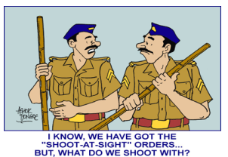

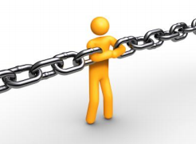
Step 5: Identify the Constraints to Be Imposed on the Solution
Constraints are restrictions on the degrees of freedom we have in providing a solution.
Each constraint has the potential to severely restrict our ability to deliver a solution as we visualize it. Therefore, each constraint must be carefully considered as part of the planning process.
A variety of sources of constraints must be considered.
These constraints may be given to us before we even begin or we may have to actively elicit them.

Slide 21
Step 5: Identify the Constraints to Be Imposed on the Solution
Some potential sources of constraints are listed below
Economics
Politics
Technology
Systems
Environment
Schedule & Resources

Slide 22
References
Managing Software Requirements: A Use Case Approach, Second Edition By Dean Leffingwell, Don Widrig, Addison- Wesley
http://www.processimpact.com/articles/be_analyst.pdf
http://en.wikipedia.org/wiki/Pareto_chart
http://en.wikipedia.org/wiki/Histogram

Slide 23


For any query Feel Free to ask

